Slide 1
PROSOCIAL BEHAVIORS
Name
Institutional Affiliation

Slide 2
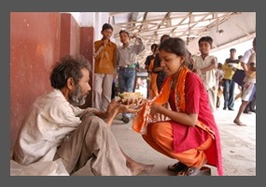
Prosocial Behaviours I Engaged in.
Prosocial behaviors
Moving door-to-door visiting less privileged people
Giving hope to the less fortunate
Showing empathy to less fortunate
Leading to : Happiness Sadness, Fear, Disgust, Anger, Surprise
A photo showing less privileged people
Notes:
While making an effort to show empathy to the needy people, one of the prosocial behavior that I engaged during the day is moving door to door to visit the less fortunate people (refugees) and giving them hope for the future and showing them sympathy. The government displaced some from their initial settlements creating disgusting life. It was claimed that they dwelt in riparian lands while others had a place to call home leaving them with fear due to poor housing and anger due to lack of basic needs such as food and water. The reaction to the behavior promoted emotional response and receiving honor from the refugees. Since some suffered from poor mental and physical health, I spent time with them to discover that they felt comfortable enough, and their emotions changed from sadness to happiness. To visit that underprivileged people and providing them with at least word of hope is a surprise to them and builds a sense of belonging

Slide 3
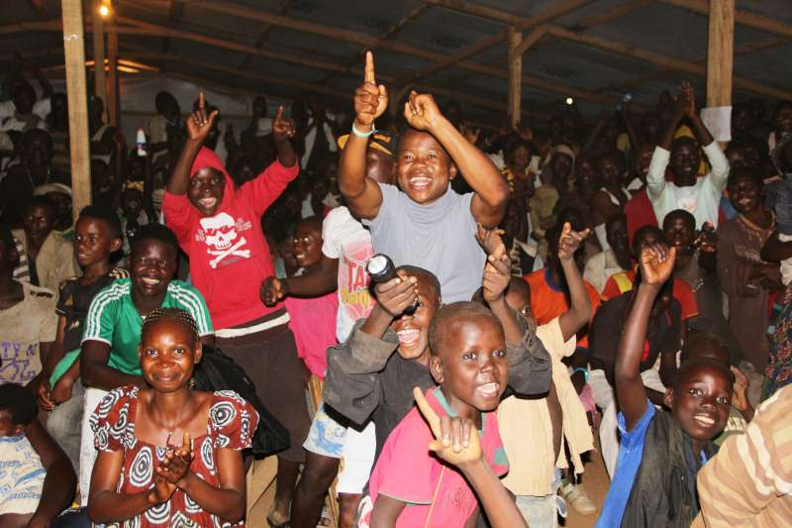
The Assessment on change of moods, attitudes, and concepts associated .
Photo showing changed of moods by visiting the minority
Mode changed from sadness to happiness
Anger to delightful mood
The concepts learned are Social norms, creativity, and attitude
Notes:
Human behavior is defined as the response of people or groups of people based on internal and external parameters. It collectively refers to the selection of each physical action and emotion that is observable in relationship to people, as well as the human race. Some behaviors will change as one grows from childhood to adulthood, while specific traits of one's personality and temperament may be encountered to be more consistent. While sharing to the minorities, their moods changed from sadness to happiness as they felt a sense of belonging. Providing them with comfort erased their anger to a mood of anger to delightful mood. Various behaviors are identified as either acceptable or unacceptable. While reviewing what I have learned about human behavior in social settings this week, the concepts such as social norms, creativity, and attitude are identified to play a pivotal role in this field of study (Akintunde, 2017).

Slide 4
Connecting experiences learned from prosocial behavior to concepts of social norms, creativity, and attitude concepts.
1. Social Norm concept towards Concern for Refugees
  Social exclusion and discrimination
  Emotional self-regulation
Notes:
The refugees and other minority groups are identified to receive various sorts of assistance from different people. However, they are confronted with social exclusion and discrimination in certain instances. In this context, I experienced the impact of social norms while trying to comfort the refugees (Nyborg, 2018). Emotional self-regulation, a more significant percentage, is attuned to the particularities based on the social situation on the table. The appropriate emotion at a specific period and its effectiveness ought to be expressed concerning social status as well as personalities of involved individuals. Both identity and context are intertwined regarding how the state of emotion is regulated.

Slide 5
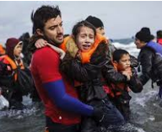
Connecting experiences learned from prosocial behavior to concepts of social norms, creativity, and attitude.
2. Creativity Concept towards Concern for Refugees
  Originality of creativity
  Fluency or flexibility
  content general or content-specific measures of creativity
Image showing empathy
Notes:
Creativity Concept towards Concern for Refugees
While conducting prosocial behavior to visit and lay hope to the refugees and show them sympathy, I found the concept of creativity applicable in a significant way. From experience, the findings demonstrate that compassion brings about the originality of creativity. However, it does not tend to foster either fluency or flexibility (Yang, H., & Yang, 2016) as it is evaluated by either of the two perspectives, i.e., content general or content-specific measures of creativity. Besides, the significant effect of sympathy based on the originality is show-cased by the differences of trait sympathy at the personal level. The connection between comfort and creativity is accorded for some reasons in that sympathy’s motivational route may tend to facilitate creativity.

Slide 6
Connecting experiences learned from prosocial behavior to concepts of social norms, creativity, and attitude.
3. Concept of Attitude towards Concern for Refugees
  Motivate the host-society children
  Value-added attitudes and involvement
  Improve out-group attitudes at large
Notes:
In connection with the prosocial behavior of showing concern towards the refugees, the concept of attitude is directly exposed in the context. It shows that empathy can be applied to encourage and motivate the host-society children who have no place to call home and do not have the parents or guardians to look after them (Glen, Taylor, & Dautel, J2020). It develops value-added attitudes and involvement in aiding and prosocial behaviors towards the refugees. From my experience, instilling the act of sympathy to the vulnerable group helps to improve out-group attitudes at large, and in the long run, increase the prosocial behavior concerning the collective out-group in the subject.

Slide 7
New insights I gained by interactions with others daily
Promotion of learning
Interacting with people from diverse cultures helps one learn about the culture and teach them about your own culture
Embracing a physical meeting with people helps one to hear their different stories first hand
minority group should be treated like other individuals and avoid generalization
Notes:
The more you interact with many people, the more you learn the different cultures. Interacting with people from diverse cultures helps one learn about the culture and teach them about your own culture (Mausbach, & Morrison, 2016). Embracing a physical meeting with people helps one to hear their different stories first hand. As we are involved in understanding other people's cultures, it is essential to note that individuals are all over us. Thus the minority group should be treated like other individuals and avoid generalization. Furthermore, insights, such as understanding various geography as well as economic practices, are learned while interacting with others. I’m likely to change my behavior by learning to imitate people we perceive as warm and nurturing.

Slide 8
Conclusion
Summary
Prosocial behavior: I moved door to door to visit the less fortunate people (refugees) and giving them hope for the future and showing them sympathy.
Work reviews on human behavior and social settings clarifying that some behaviors will change as one grows from childhood to adulthood.
Specific traits of one's personality and temperament may be encountered to be more consistent where they are acceptable or unacceptable.
Identified concepts: social norms, attitude, and creativity
New insights identified while interacting with others include the promotion of learning and understanding the geography and economic practices of diverse cultures
Notes:
In summary, the discussion is grounded on the prosocial behavior that I engaged during the day I moved door to door to visit the less fortunate people (refugees) and giving them hope for the future and showing them sympathy. Further, the work reviews on human behavior and social settings clarifying that some behaviors will change as one grows from childhood to adulthood. At the same time, specific traits of one's personality and temperament may be encountered to be more consistent where they are acceptable or unacceptable. The three concepts, social norms, attitude, and creativity, are identified and connected to the prosocial behavior in the subject. Finally, new insights identified while interacting with others include the promotion of learning and understanding the geography and economic practices of diverse cultures.

Slide 9
References
Akintunde, E. A. (2017). Theories and concepts for human behavior in environmental preservation.
Glen, C., Taylor, L. K., & Dautel, J. B. (2020). Promoting Prosocial Behavior Toward Refugees: Exploring the Empathy-Attitude-Action Model in Middle Childhood. In Children and Peace (pp. 71-87). Springer, Cham.
Mausbach, A. T., & Morrison, K. (2016). Development of a Safe Culture that Promotes Learning. In-School Leadership through the Seasons (pp. 41-56). Routledge.
Nyborg, K. (2018). Social norms and the environment. Annual Review of Resource Economics.
Yang, H., & Yang, S. (2016). Sympathy fuels creativity: The beneficial effects of sympathy on originality. Thinking Skills and Creativity, 21, 132-143.

